Slide 1
Leading in Uncertain Times:
Promoting Self-Care & Boundaries Through Energy Management
Jeannine Moga, MA, MSW, LCSW
Veterinary Social Worker, Banfield Health & Wellbeing Team

Slide 2
Good Boundaries Improve Self-Regulation
Adaptable
Empowered and effective
Flexibility
Shift gears with confidence
Engaged
Invested and connected
  People who have a strong ability to self-regulate are described as:
  Adaptable
  Flexible
  Engaged despite the existence of uncertainty

Slide 3




Good Boundaries = Energy Management
Based on Schwartz & McCarthy (2007)
Physical:
Obey Your biology
Emotional:
Amplify Positivity
Mental:
Protect FOCUS
Spiritual:
Prioritize purpose
Sleep hygiene
Exercise
Nutrition & hydration
Mini-breaks every 90-120 mins
Deep belly breathing
Appreciation & gratitude
Change your lens: reverse/long/wide
Reduce interruptions
Compartmentalize
Prioritize challenges
Find your “sweet spot”
Live your values
Put important relationships and activities first

Slide 4
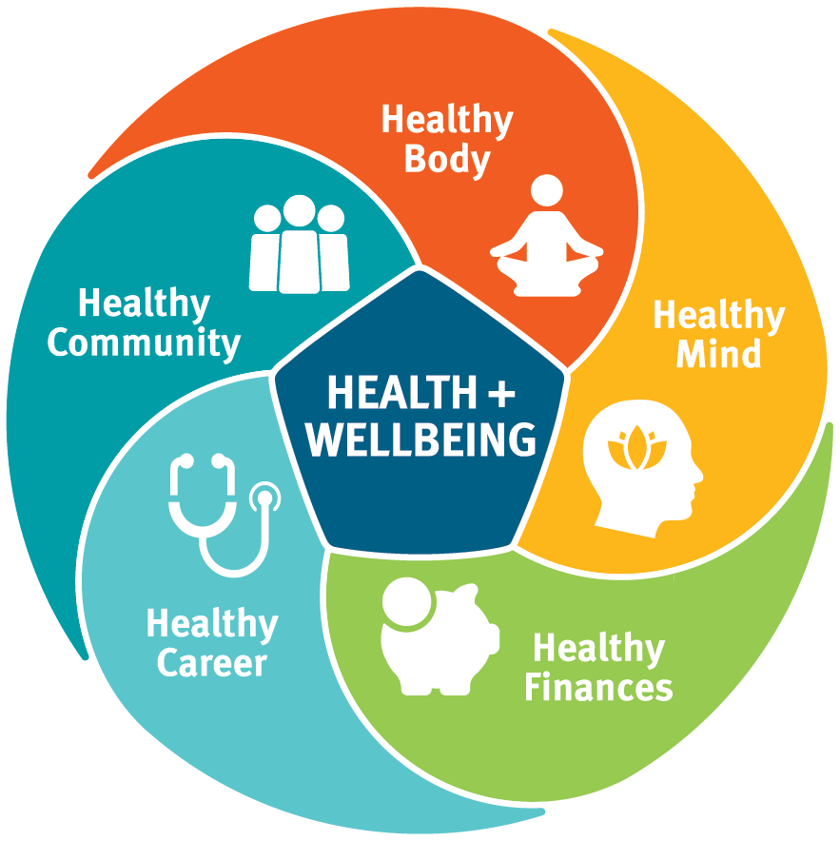
Starting the Conversation
Team huddles
  Start with an “energy check”
  Change the lens with debriefs
  Share gratitude
  Encourage micro breaks
Individual check-ins
  Model, communicate and enable good boundaries
  “What helps you to restore energy? How can you do
  more of that?”
First Steps
Making boundaries concrete empowers healthy behaviors

Slide 5
Health & Wellbeing Resources
My H&W Resources
MD- Live Regence
Virtual Community
Magnets in hospital
Digital H&W coaching
Counseling (5)
Emotional Wellbeing App
Preview offerings in this video >
Confidential-24/7 888.912-1043
myhealthandwellbeingresources.com
Doctor visits
Counselors
Psychiatrist – Medication
The module will guide members through:
MDLive How to video
MDLIVE.com/Regence
Customer Service- 888.725-3097
General
Kids + Families
H&W
Development
Leadership
MVH Virtual Community Toolkit
Banfield Associate Resources

