Slide 1
Holidays
During a Pandemic
Planning & Support that Includes Our Individual Unique Realities
Presenter: Lisa Stewart-Brown, LCSW
November 20, 2020
Sponsored by PRIDE and NEXT GEN

Slide 2

please join us in observing a moment of silence
in memory of all those that have been lost before their time
and to signify our solidarity as an inclusive community

Slide 3
Expectations and Considerations-Big Picture
Covid-19
safety recommendations
Larger World
marketing
“should”
Personal
history & family situations
Finances
Work & budgets

Slide 4
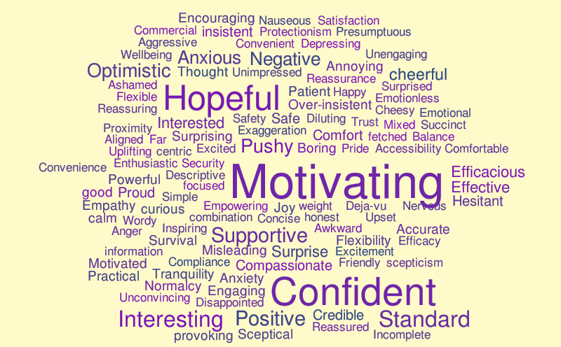
Holidays and Mixed Emotions- Personal View
Realities
Memories
Anticipation
Traditions
Expectations
Interactions with others
Solitary time

Slide 5
Planning that Includes Individual Unique Realities
enjoy
COVID-19 safety checklist
who & what are meaningful
make a holiday plan
if I did not consider other’s feelings what do I really want
talk about the possibilities
communicate needs
Safety First
  Realities & Perspective
  Covid 19- checklist
Self-Awareness
What is truly important to me?
Creating and Activating a Plan
  Plan
  Communicate needs
  Talk about possibilities

Slide 6

Planning Solitary Holidays
Many amazing people may be alone during holidays due to… (estranged relationships, death, distance,
choice, safety, etc.)
Introvert
Extrovert
How would it feel for you to take time for yourself and do something you really enjoy?
Would it be meaningful to create a tradition for those in your life that are no longer here to celebrate?
The friends in your circle of trust. If you knew you would be accepted, would you want to celebrate with them?
Would it feel good for you to support others without traditional families and volunteer, or host a “safe” holiday event?

Slide 7
Planning to Include Friends and Family
Who is a priority for me?
  Think about or find out what the person(s) wants or expects.
  Do their wishes fit mine? If not, break out each item and review.
    My significant other is not welcome
    They are not willing to wear a mask
    Concerns around alcohol, hot button topics, etc.
  Consider allies or “holiday” buddies in your plan design.
The plan
Safety & perspective
Ground the plan in “My Answer”
Write it down (for you)
My Answer
If I did not consider other’s feelings, what do I really want?

Slide 8

Communication and Possibilities
Who is it important to communicate your plan to?
  When sharing your plans, think about what you want to say & how you want to say it ahead of time.
  Facts & I statements may reduce the listeners defensiveness.
  Stay curious and seek to understand their point of view.
Possibilities to Consider - segue starters
  Are you open to talking about other ways we could have our holiday this year?
  I’m sad we can’t be together too, and I would like to talk about what else we could do that may be nice for this “bizarre” year, how does that sound?
My Answer
If I did not consider other’s feelings, what do I really want?

Slide 9
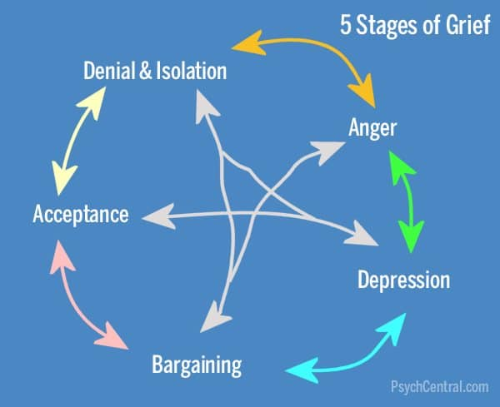
Support During the Holidays and a Pandemic
Holidays are emotional, and that’s “human.”
Let’s anticipate that we will feel a range of emotions and think about what may help.
Try to check expectations at the door & instead let’s see what happens.
Resist making up stories about other’s behaviors and focus on staying curious.
Acceptance – we are all “humans” extend grace when possible. To others and to ourselves!
Seek support from allies + buddies.
Boundaries are smart, take space, timeouts or “time to leave.”

Slide 10
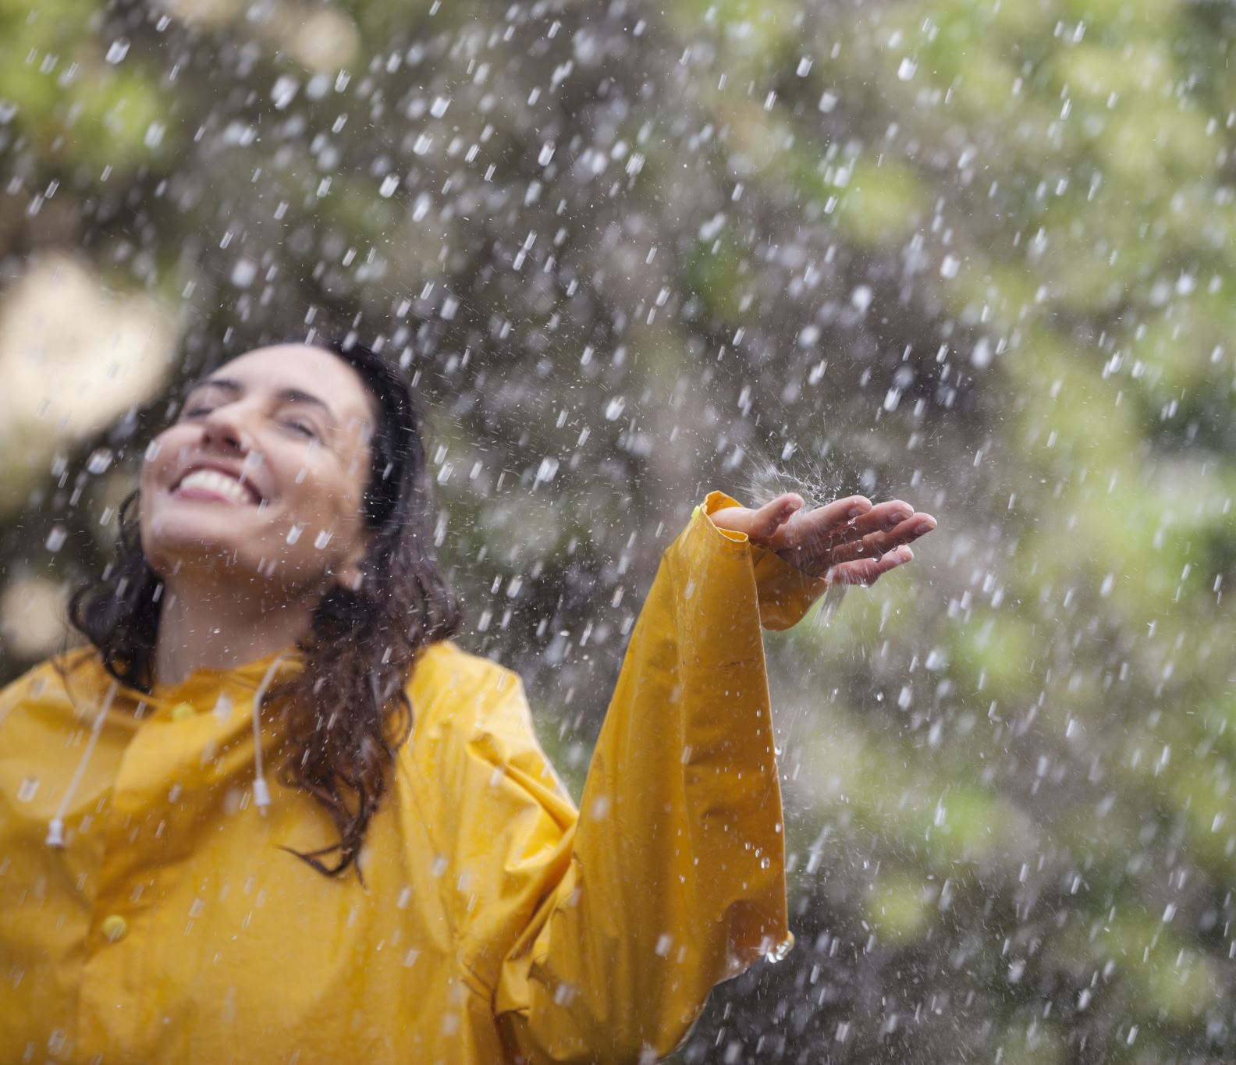
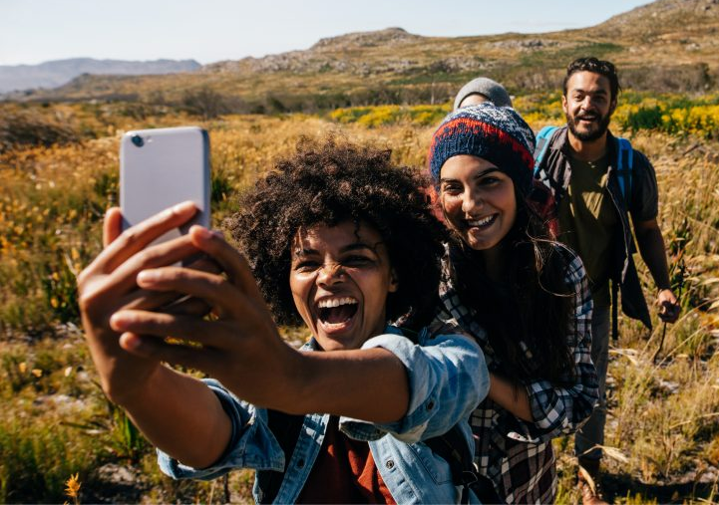

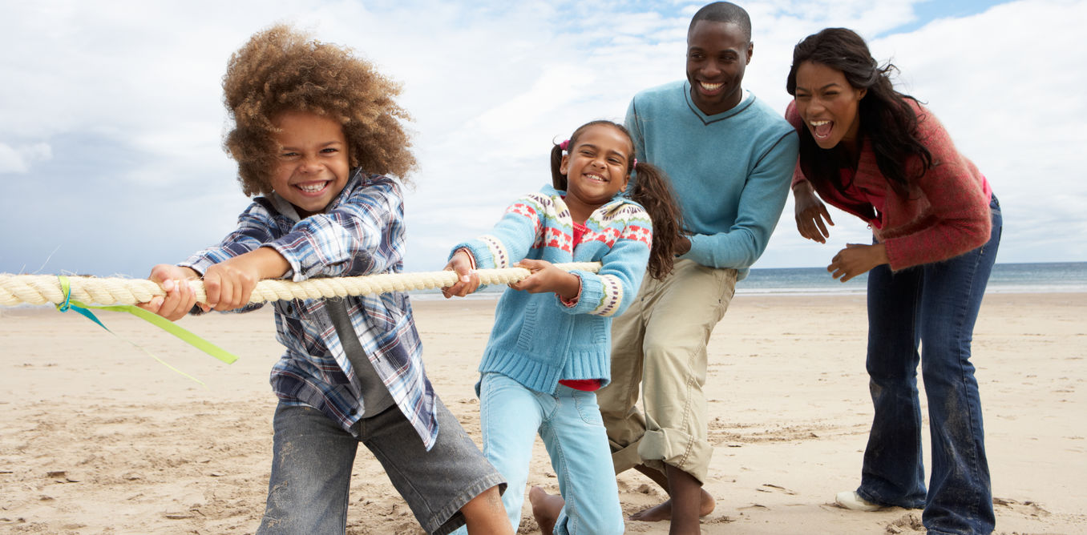
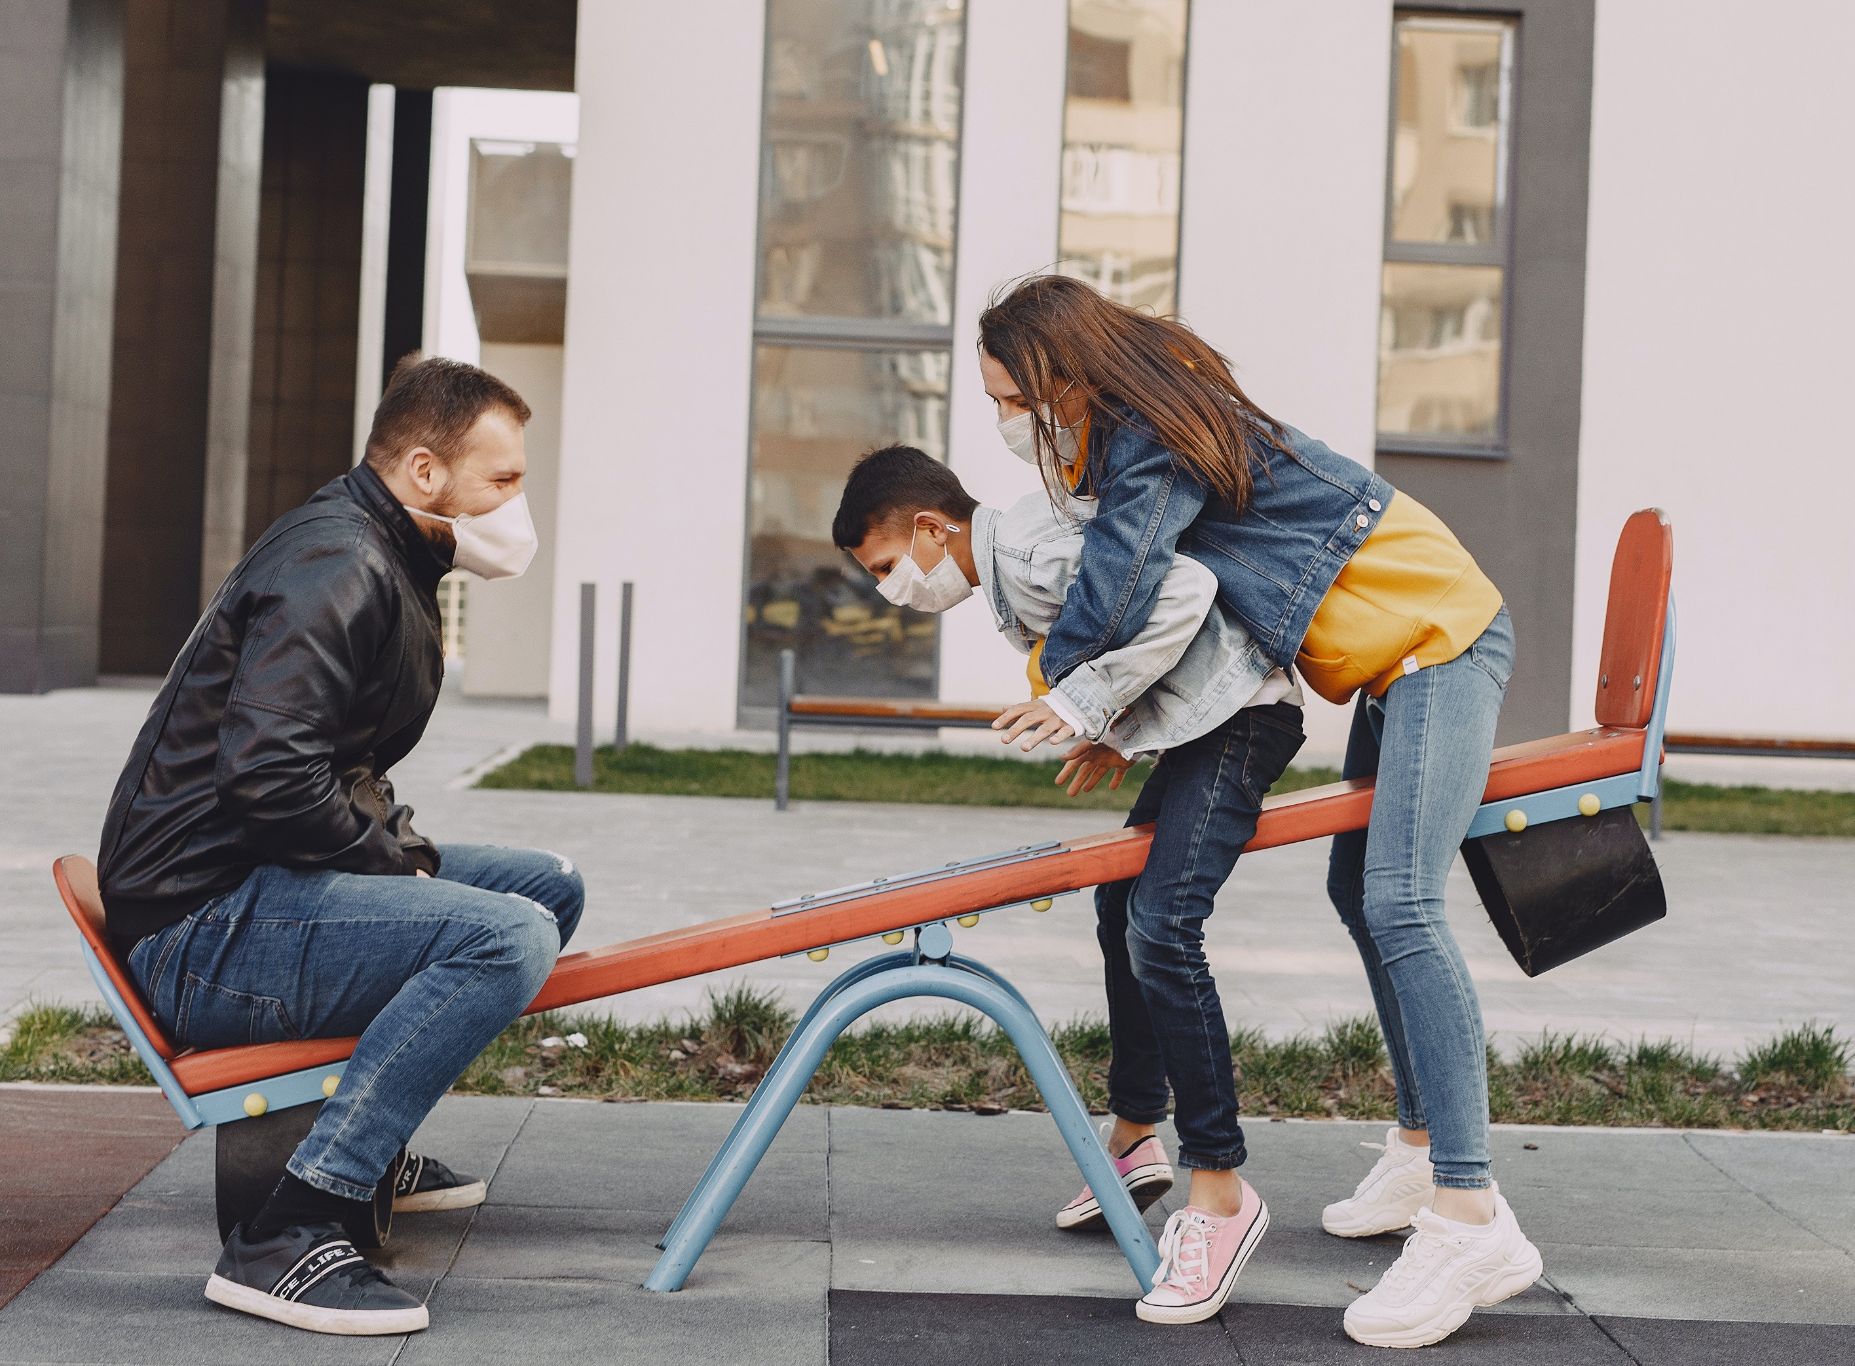

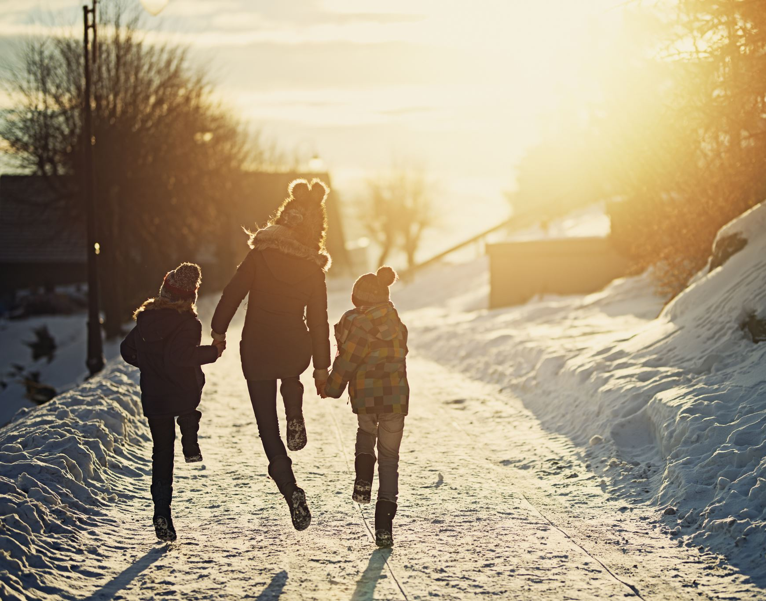
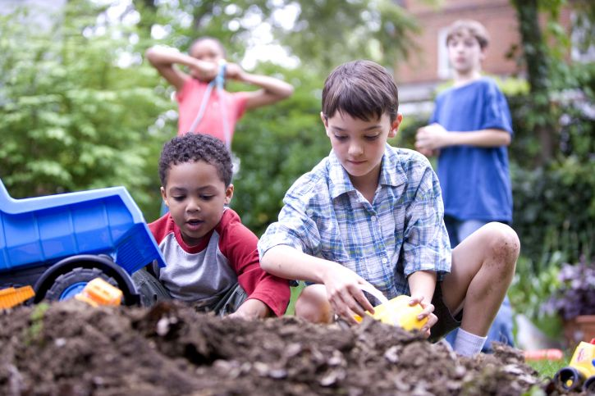
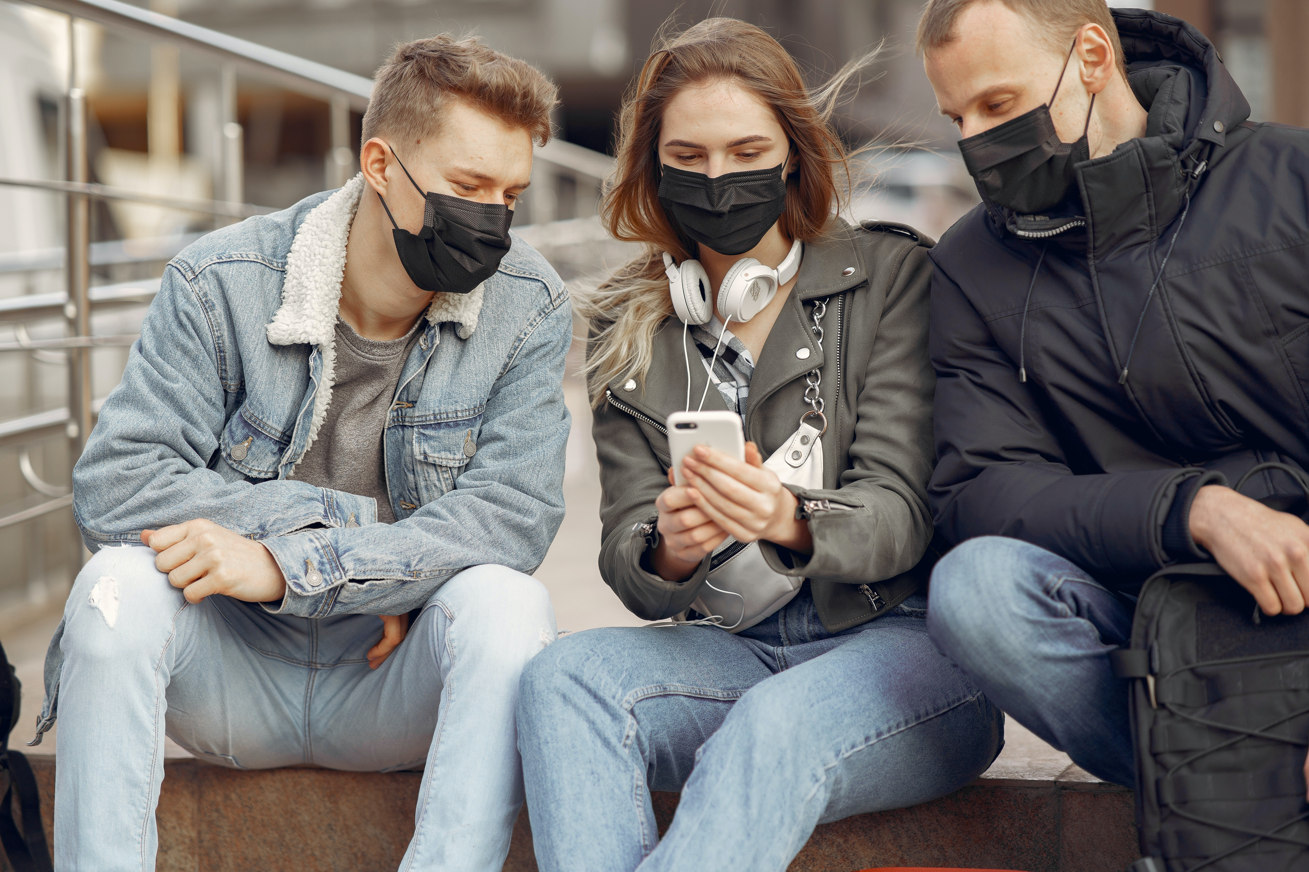
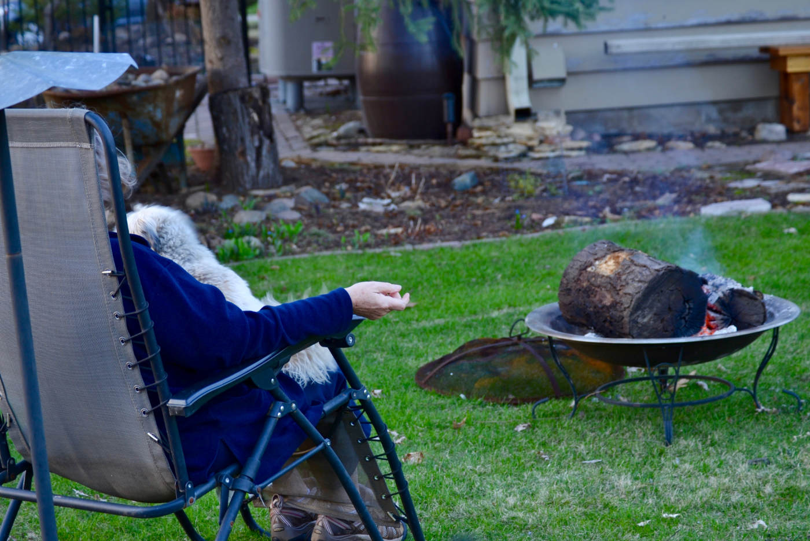
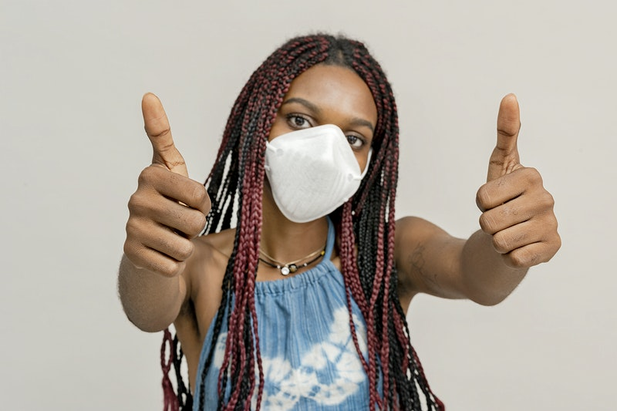
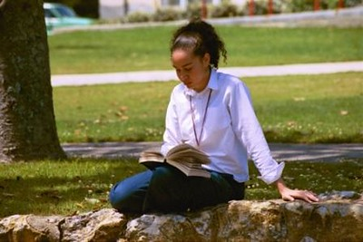
Key Take Aways
Safety
Review the checklist
Self-Awareness
What ‘s truly important to me?
Creating a Plan
This is the year for out of the box thinking and making new traditions.
Don’t forget to leverage virtual technology.
    Zoom, face time, etc.
    Watching movies together virtually.
    There are people who care, and you matter, you are NOT alone.
enjoy
COVID-19 safety checklist
who & what are meaningful
make a holiday plan
if I did not consider other’s feelings what do I really want
talk about the possibilities
communicate needs

Slide 11
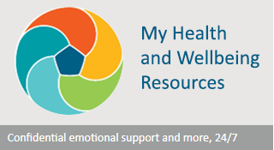
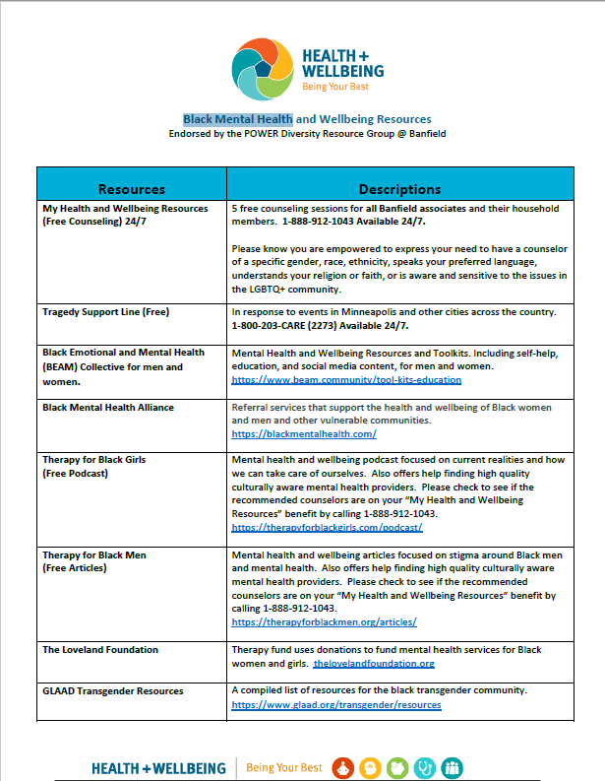
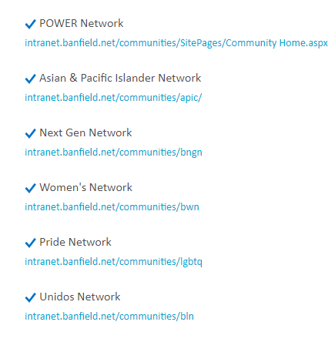
Resources
Banfield Resources
Community Resources
The American Psychological Association (APA) provides countless educational and support resources on a range of LGBTQ topics
The Association for Lesbian, Gay, Bisexual & Transgender Issues in Counseling delivers educational and support resources for LGBTQ individuals, as well as promoting competency on LGBTQ issues for counseling professionals
The Association of Gay and Lesbian Psychiatrists offers numerous resources for LGBT individuals experiencing mental health conditions and psychiatric professionals with LGBT clients
The National Center for Transgender Equality offers resources for transgender individuals, including information on the right to access health care
The Trevor Project is a support network for LGBTQ youth providing crisis intervention and suicide prevention, including a 24-hour text line (Text “START” to 678678)
The LGBT National Help Center offers confidential peer support connections for LGBT youth, adults and seniors including phone, text and online chat
The Gay and Lesbian Medical Association's Provider Directory is a search tool that can locate a LGBTQ-inclusive health care provider
Black Mental Health Resources on FETCH
Access the website
Access FETCH DRG's

Slide 12
Questions?

