Slide 1
Leading in Uncertain Times:
Unmasking Compassion Fatigue
Jeannine Moga, MA, MSW, LCSW
Veterinary Social worker, Banfield Health & Wellbeing Team

Slide 2

Making the Connection: Name It & Tame It
  Mental Framework
    How do I explain what is happening?
  Reducing Stigma
  Is it just me? (It isn’t!)
  Social Support/Connection
    From “I” to “We”: Restoring wellbeing in this work
Personal Perspectives
What We Tell Ourselves Matters

Slide 3
Phases of Compassion Fatigue
Based on Fakkema (2009)
Zealot
Enthusiastic & Engaged
Withdrawal
Drained & Careless
Zombie
Detached & Intolerant
Irritability
Cynical & Insufficient
R
E
N
E
W
A
L
Renewal
Self-Awareness, Resource Activation, and Self-Restoration

Slide 4
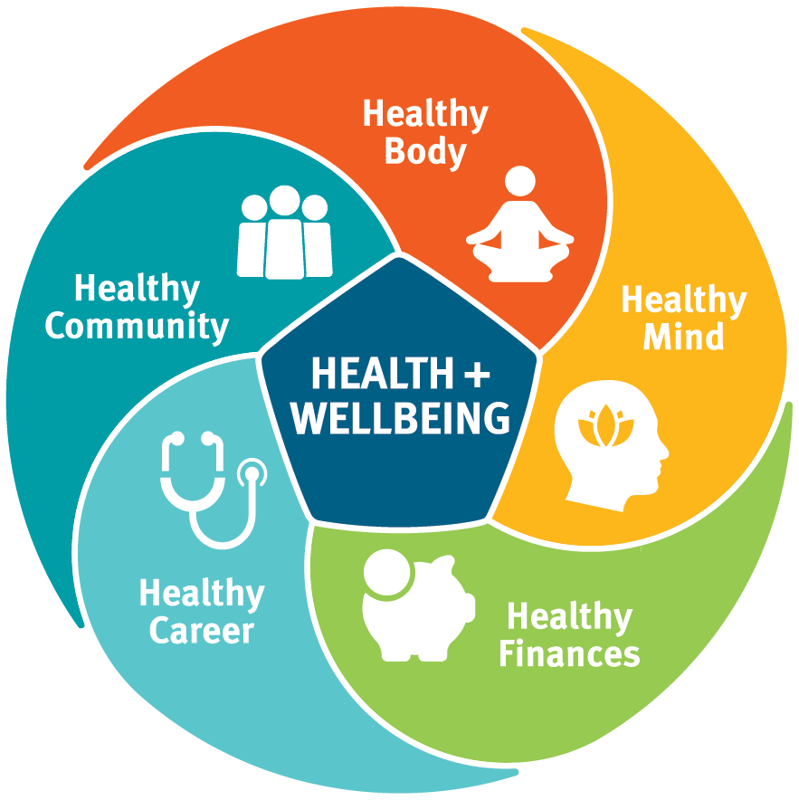
Starting the Conversation
Team huddles
  “On the scale of Zealot to Zombie, where are you
  today?”
  “What’s one thing we can do to support well-
  being this week?”
Individual check-ins
  ”How are you taking care of yourself?”
  Resource reminders
First Steps
Taking our pulse – and talking about it – creates a culture of self-care

Slide 5
Health & Wellbeing Resources
My H&W Resources
MD- Live Regence
Virtual Community
Magnets in hospital
Digital H&W coaching
Counseling (5)
Emotional Wellbeing App
Confidential-24/7 888.912-1043
myhealthandwellbeingresources.com
Doctor visits
Counselors
Psychiatrist – Medication
The module will guide members through:
MDLive How to video
MDLIVE.com/Regence
Customer Service- 888.725-3097
General
Kids + Families
H&W
Development
Leadership
MVH Virtual Community Toolkit
Banfield Associate Resources

