Slide 1
“Strong Back, Soft Front”:
Leading With Resilience
Jeannine Moga, MA, MSW, LCSW
Veterinary Social Worker, Banfield Health & Wellbeing Team

Slide 2
“Helping, fixing, and serving represent three different ways of seeing life.
-When you help, you see life as weak.
-When you fix, you see life as broken.
-When you serve, you see life as whole.”
— Joan Halifax

Slide 3
Soft Back, Armored Front:
Leaders on emotional Lockdown
Burnout
Compassion Fatigue
Self Sacrifice
Moral Distress
Soft Back
Constant pressure to up-regulate
Crisis of “shoulds”
Over-stimulation, vital exhaustion, and “pathological altruism” abound
Notes:
Path. Altruism = reduce my anxiety/gratify my needs by serving you; saying ‘no’ causes me anxiety; up regulation = gas pedal (do more, faster)

Slide 4


Healthy Roots Grow “Strong Backs/Soft Fronts” (Halifax, 2011; 2018)
Healthy Roots
Strong Backs/Soft Fronts
Holistic health & wellbeing: self awareness + restoration + resources
Activating core principles and values
Cultivating mindfulness + growth mindset
The capacity to uphold ourselves through chronic strain while opening to the world as it is
Equanimity + compassion

Slide 5
Leading With Resilience
Soft Back
Burnout
Compassion Fatigue
Self Sacrifice
Moral Distress
Strong Back
Empathy
Wise Action
Integrity
Respect
Self-care =
core strength
“Healthy selfishness” supports strong backs and strong leadership

Slide 6
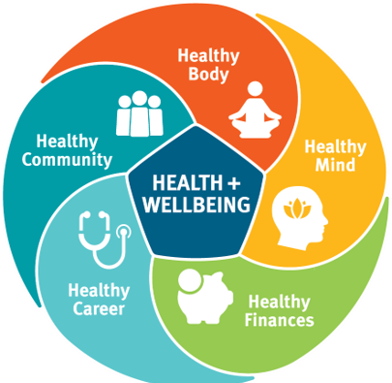
Cultivating “Healthy Selfishness”
How can I down-regulate?
Micro breaks, focus time, down time
What lights me up?
Prioritize joy, meaning, and restoration.
How can I practice self compassion? Give – and receive – grace.
The time to begin is now!
Self-care is good stewardship and an ethical requirement to do no harm
Notes:
Micro breaks, prioritizing, tech time off are all useful for down regulation

Slide 7
Associate Health & Wellbeing Resources
My H&W Resources
Tele-Health
Regence
In This Together
Associates + Household Members
Counseling (5 free visits)
Digital H&W coaching
  Stress
  Sleep
  Food
My Health & Wellbeing Resources- Instructional Guide
myhealthandwellbeingresources.com
Confidential-24/7
888.912-1043
Tele-Health Covered 100% (2020/2021)
Doctor visits
Counselors
Psychiatrist – Medication
The module will guide members through: MDLive How to video
MDLIVE.com/Regence
Customer Service- 888.725-3097
Self-Care Tools/Resources
Custom Webinars
  Self-Care
  Supporting others
  Leadership
  Boundaries
Podcast
Articles
mvh4you.com
Notes:
This is a confidential resources, and we are provided high level aggregated information and we have had over 900 of our associates and /or their household members engage in self-care by leveraging their free counseling support visits this year!!

